Slide 1

RMD Sinhgad School of Engineering Department of Computer Engineering “Project Title”
Presented By:
Guide Name:
Dept. of Computer Engineering, RMDSSOE

Slide 2
Contents
Introduction
Objectives
Project Goal
Future scope of Domain
Scope of project
Literature survey
Dept. of Computer Engineering, RMDSSOE

Slide 3
Introduction
What Are Basic Concepts?
Examples and Introduction
Dept. of Computer Engineering, RMDSSOE

Slide 4
OBJECTIVES
List Multiple objective and starting every objective with “To”
Dept. of Computer Engineering, RMDSSOE

Slide 5
GOAL OF PROJECT
Dept. of Computer Engineering, RMDSSOE

Slide 6
Future Scope Of Domain
In Research and Scientific Discovery
In Cyber Security
In Data Analysis
In Medical Science
In Transport Systems
In Home Automation
Dept. of Computer Engineering, RMDSSOE

Slide 7
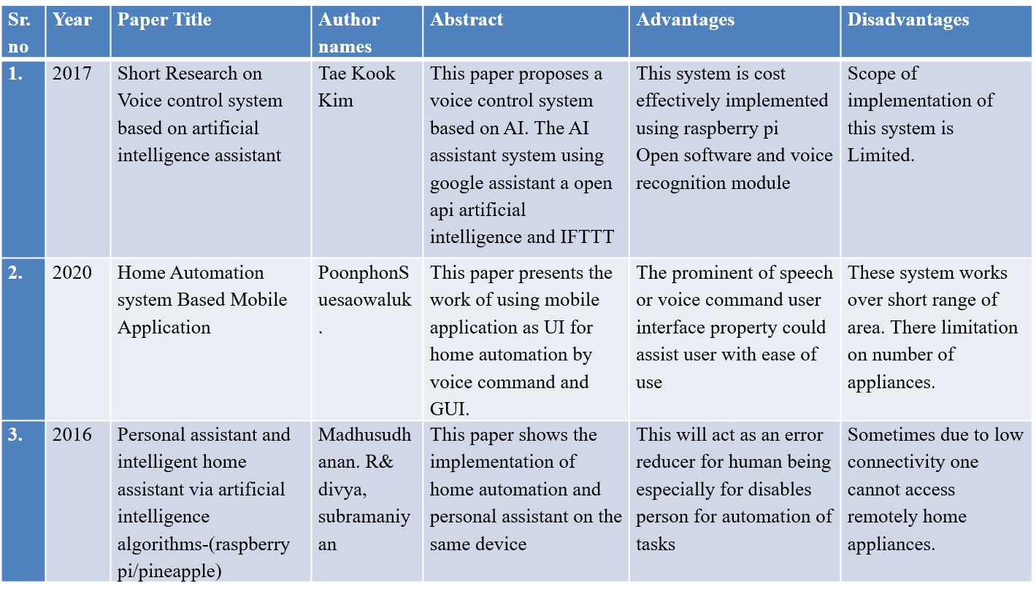
Literature Survey

Slide 8
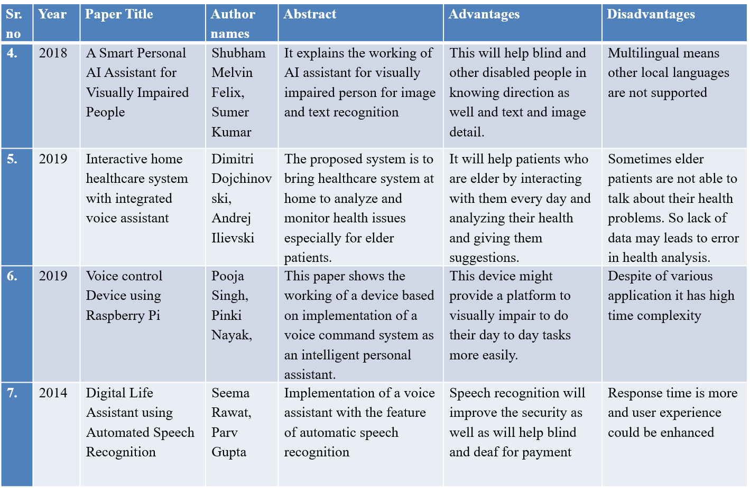
Literature Survey
Literature Survey

Slide 9
Problem statement & Hypothesis
E.g.To remove the inability of the Voice assistant to support multiple voices and increase efficiency.

